Slide 1
Elastic APM
Justin Chao
March 30, 2020

Slide 2
Three Pillars of Observability

Slide 3
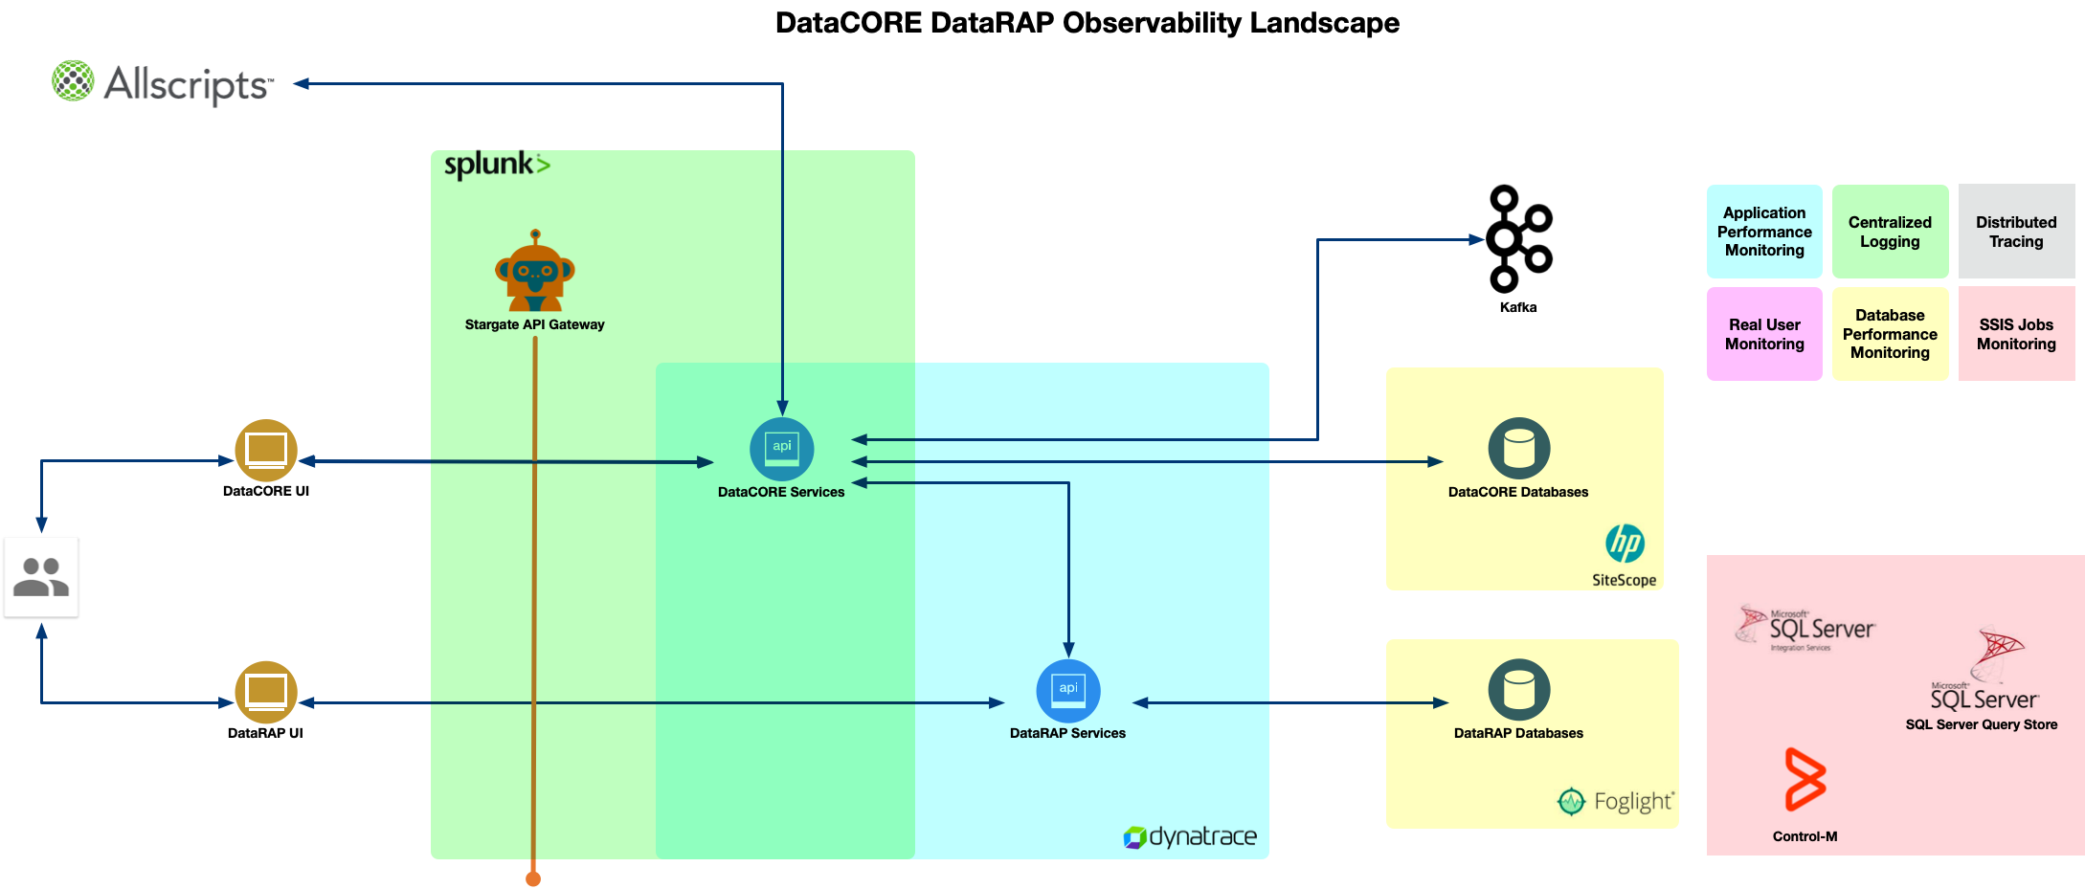
Current Observability Landscape
Notes:
Lacking:
RUM for front-end, how is the impact for end-users? Ie: page content loads
Enough Dynatrace agents for scalability of services? `
Distributed Tracing across microservices
Centralized Logging and correlation
Can we do better?

Slide 4
Elastic APM

Slide 5
Supported Languages
Java
.NET
Node.js
Django
Flask
Rails
Rack
RUM - JS
Go

Slide 6
Supported Technologies
.NET Core 2.0 (or newer) .NET Framework 4.6.1 (or newer)
Web Framework | Supported Versions
ASP.NET Core | 2.1 and later
ASP.NET on IIS | 4.6.1 or newer (IIS 7.0 or newer)
Networking
System.Net.Http.HttpClient on .NET Core
System.Net.Http.HttpClient on .NET Framework
Data access technologies | Supported Versions
Entity Framework (EF) Core | 2.x | A DB span is automatically created for each access to underlying database performed by Entity Framework Core.
Entity Framework (EF) 6 | 4.6.1 or newer (IIS 7.0 or newer) | A DB span is automatically created for each access to underlying database performed by Entity Framework 6.

Slide 7
Supported Technologies
Java
Java versions | Supported Versions
Oracle JDK | 7, 8, 9, 10, 11
Open JDK | 7, 8, 8, 10, 11
IBM J9 VM | 8
Notes:
https://www.elastic.co/guide/en/apm/agent/java/1.x/supported-technologies-details.html

Slide 8
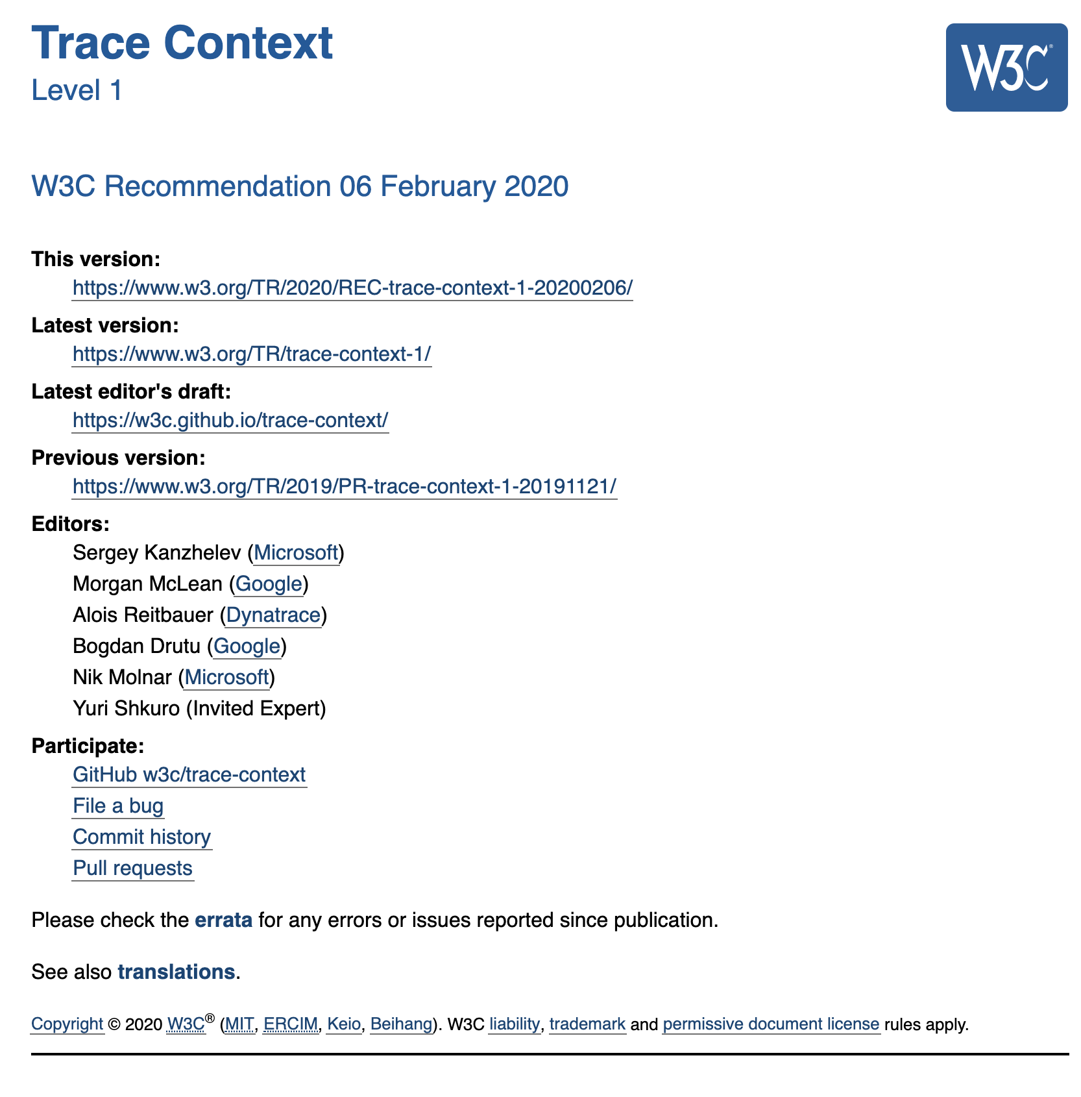
Open Standards for Distributed Tracing
Notes:
Sponsors: Google, Microsoft, Dynatrace, and New Relic
2010: Google Dapper X-Google-Cloud-Trace
Twitter: Zipkin B3 format
Uber: Uber format

Slide 9
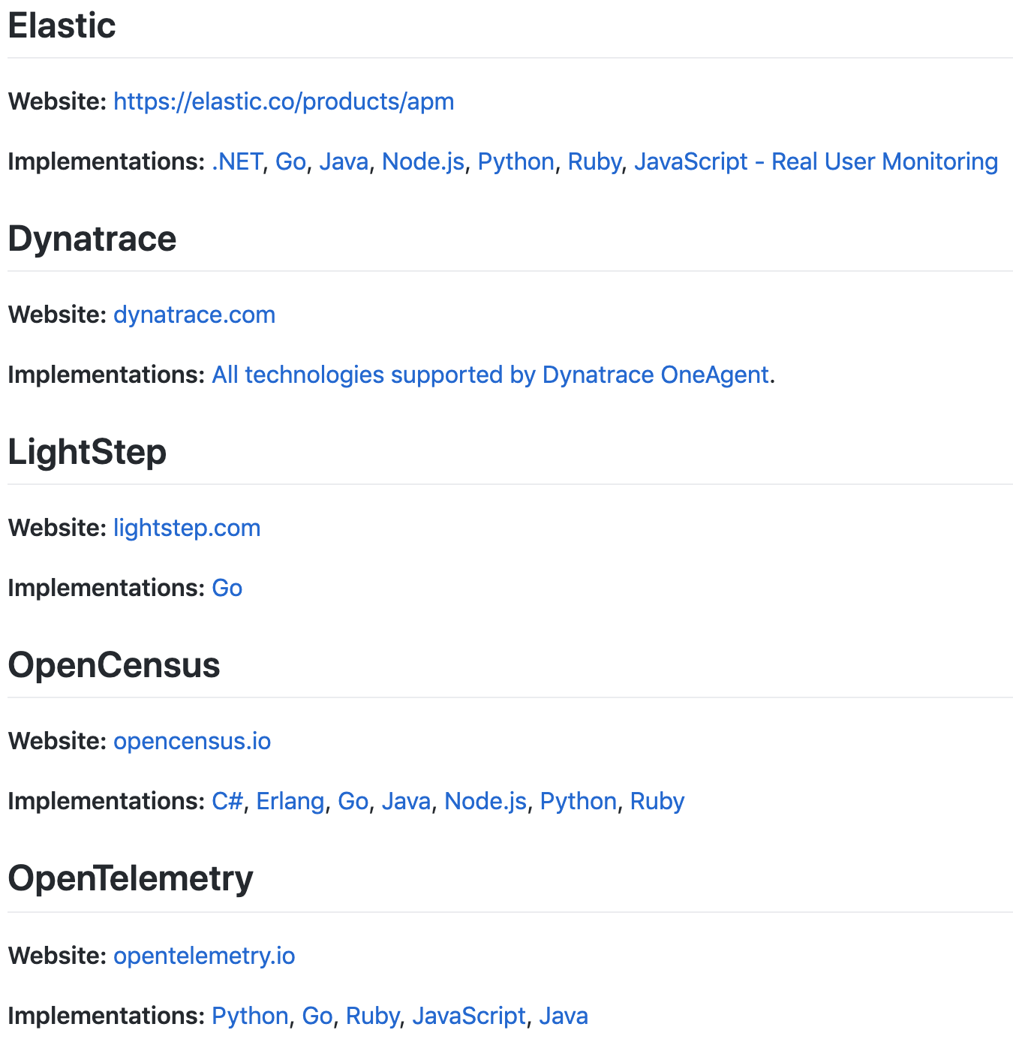
Implementations of w3c Trace Context
Notes:
Sponsors: Google, Microsoft, Dynatrace, and New Relic
2010: Google Dapper X-Google-Cloud-Trace
Twitter: Zipkin B3 format
Uber: Uber format

Slide 10
Three Pillars of Observability

Slide 11
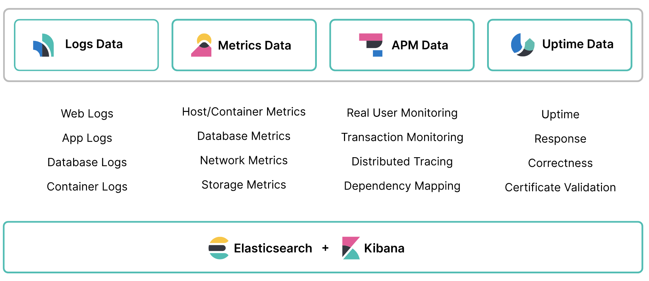
Observability Built on the Elastic Stack

Slide 12
Centralized Logging

